Slide 1
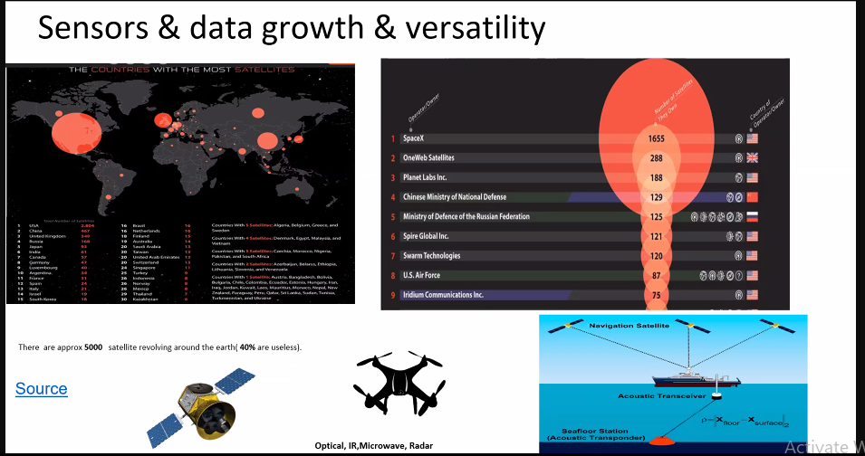
Attended the online meeting of gis and remote sensing

Slide 2
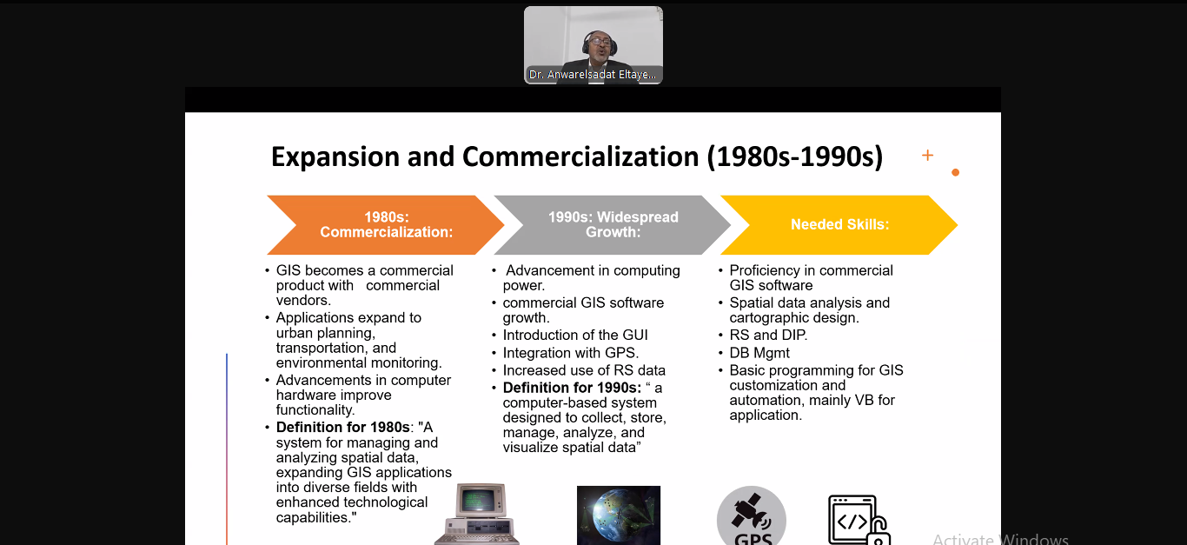

Slide 3
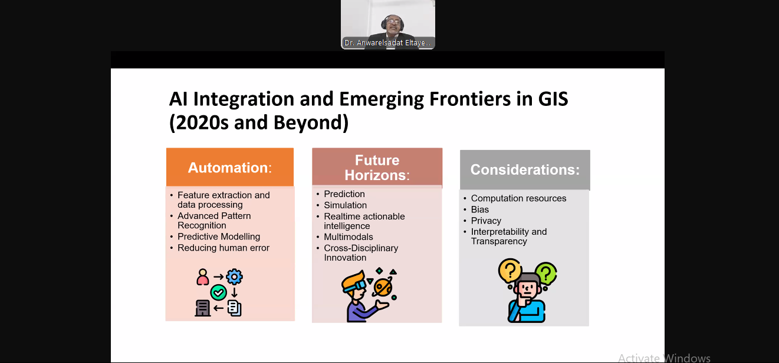

Slide 4

Google books will be a good resource
Wroked in many projects in arcgis pro as followas
And collectded the data form many websites

Slide 5
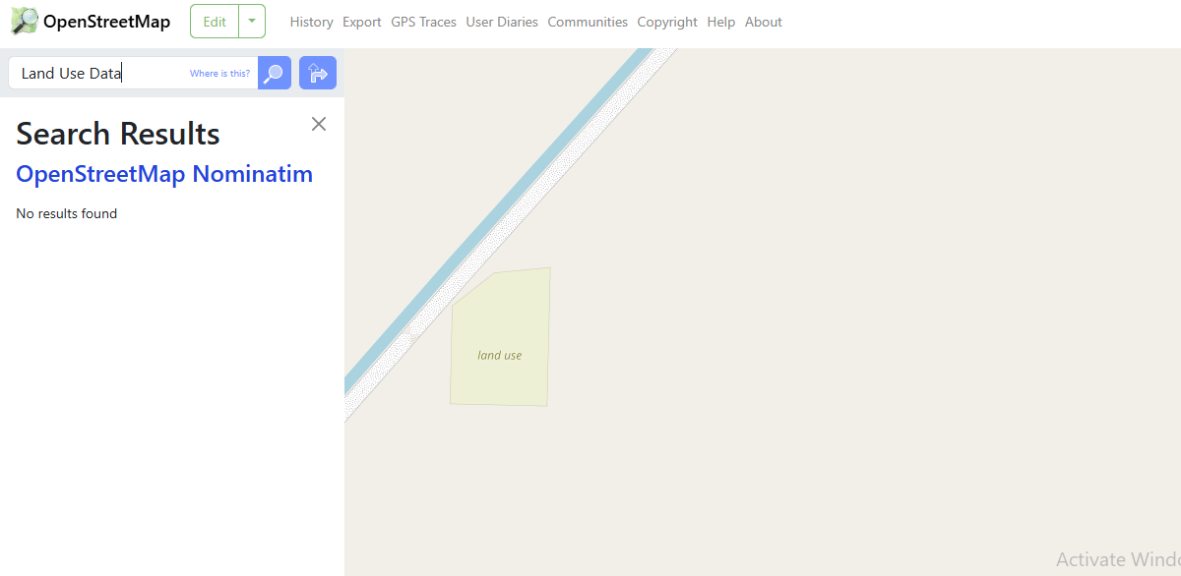

Slide 6
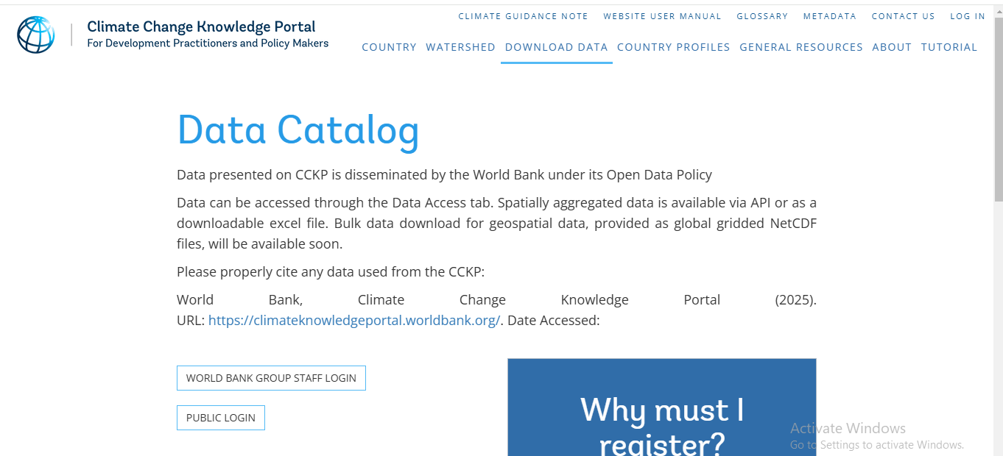

Slide 7
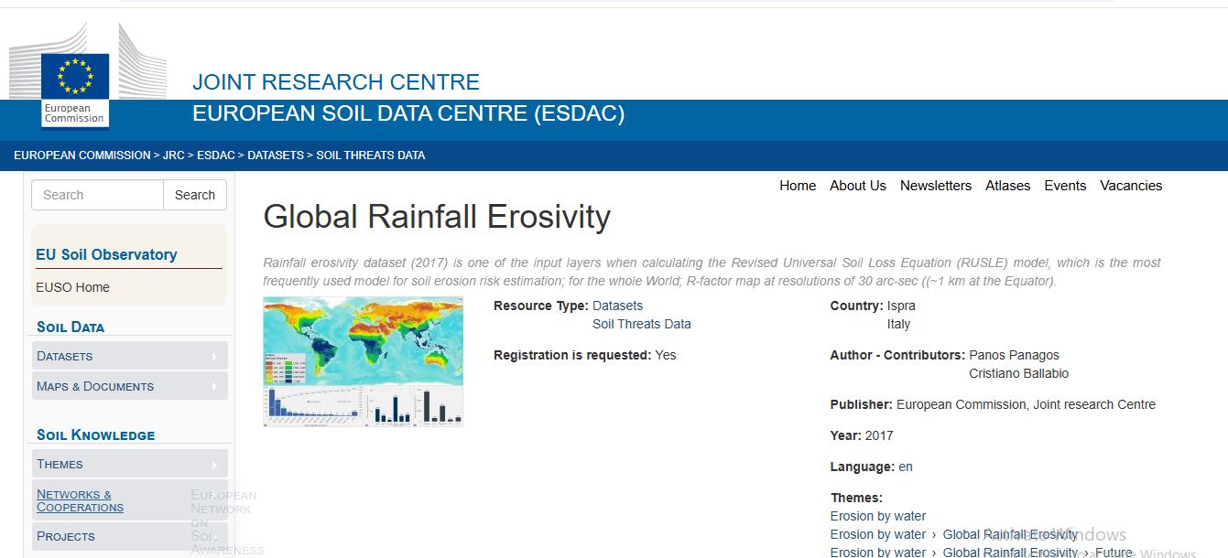

Slide 8
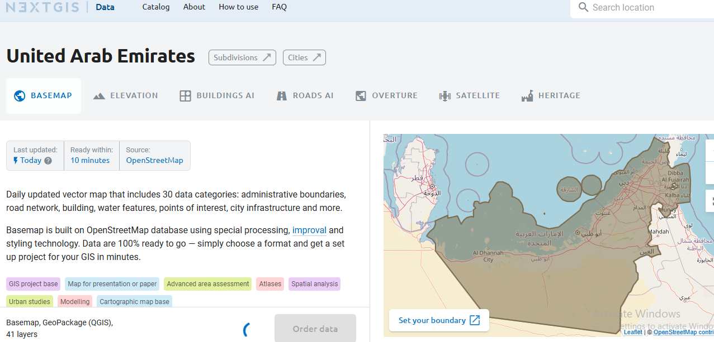

Slide 9
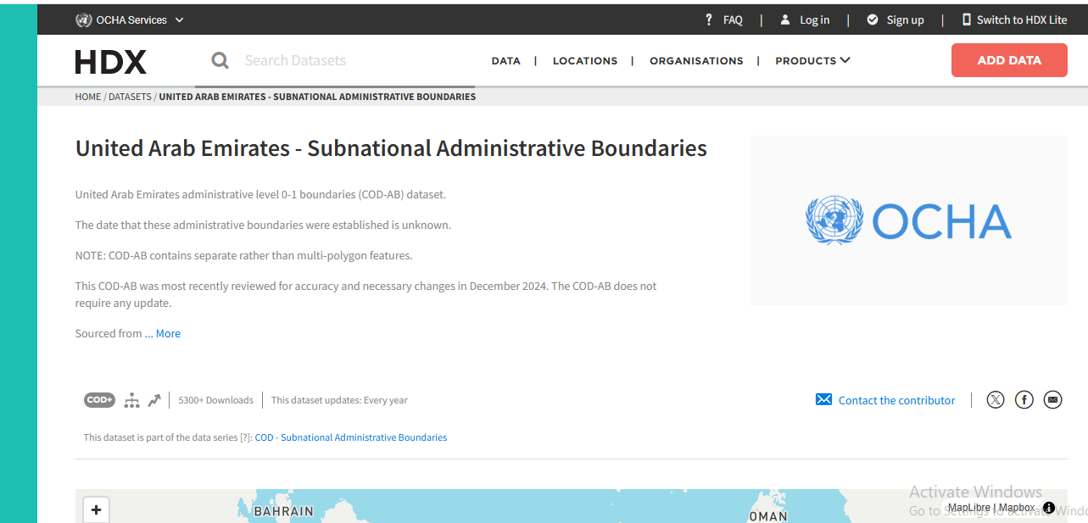

Slide 10
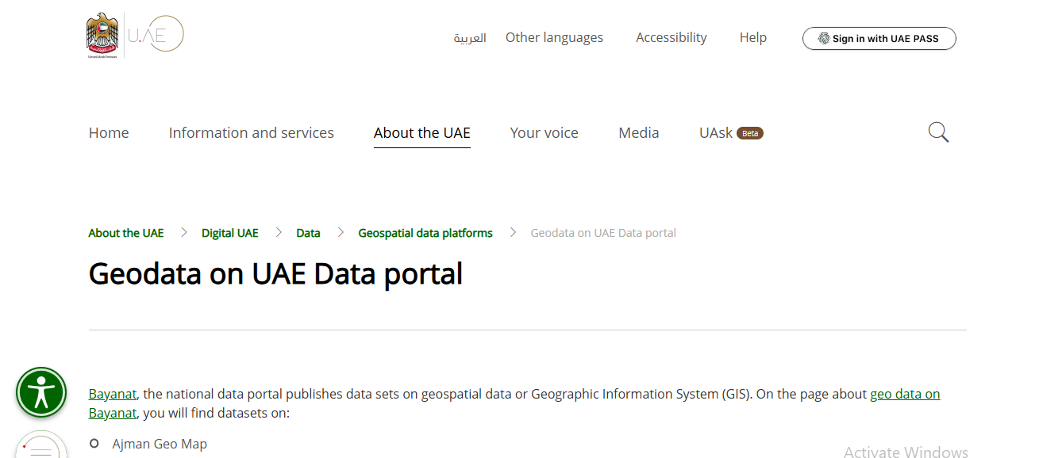

Slide 11
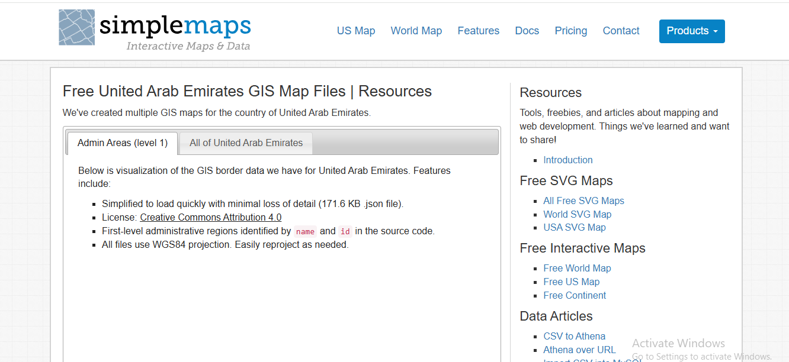

Slide 12
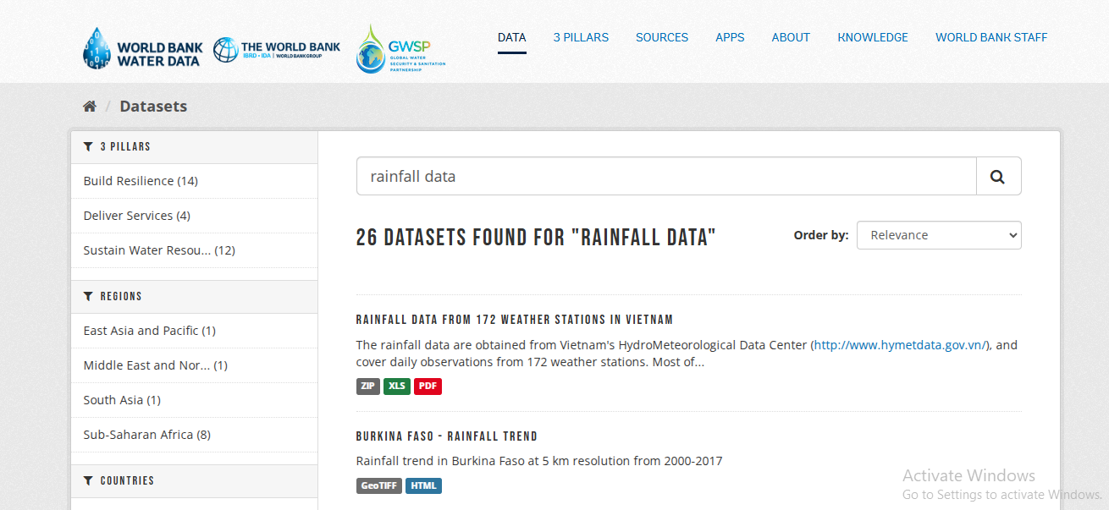

Slide 13
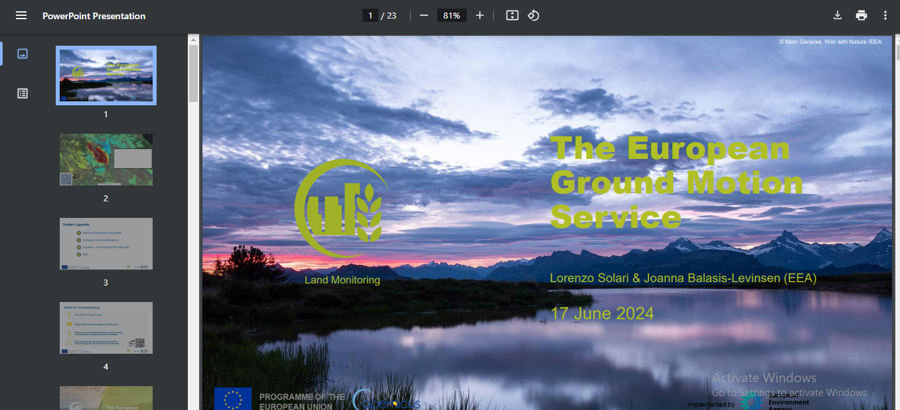

Slide 14
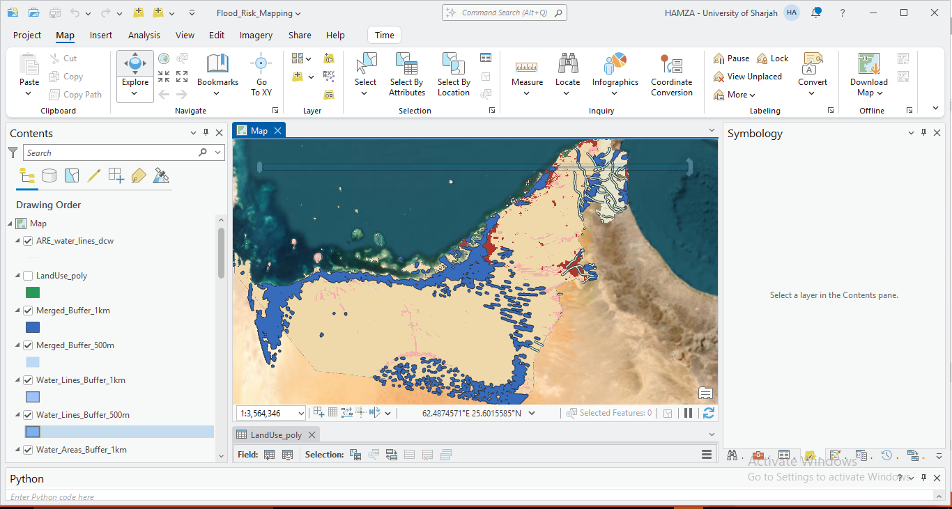
Here is the 2 main projects I work in :

Slide 15
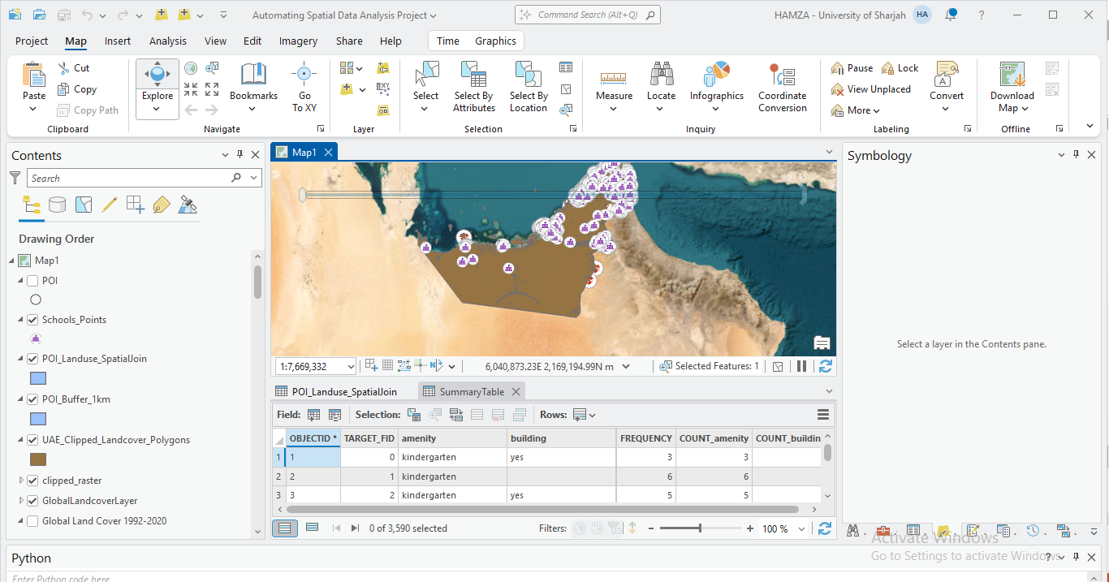

Slide 16
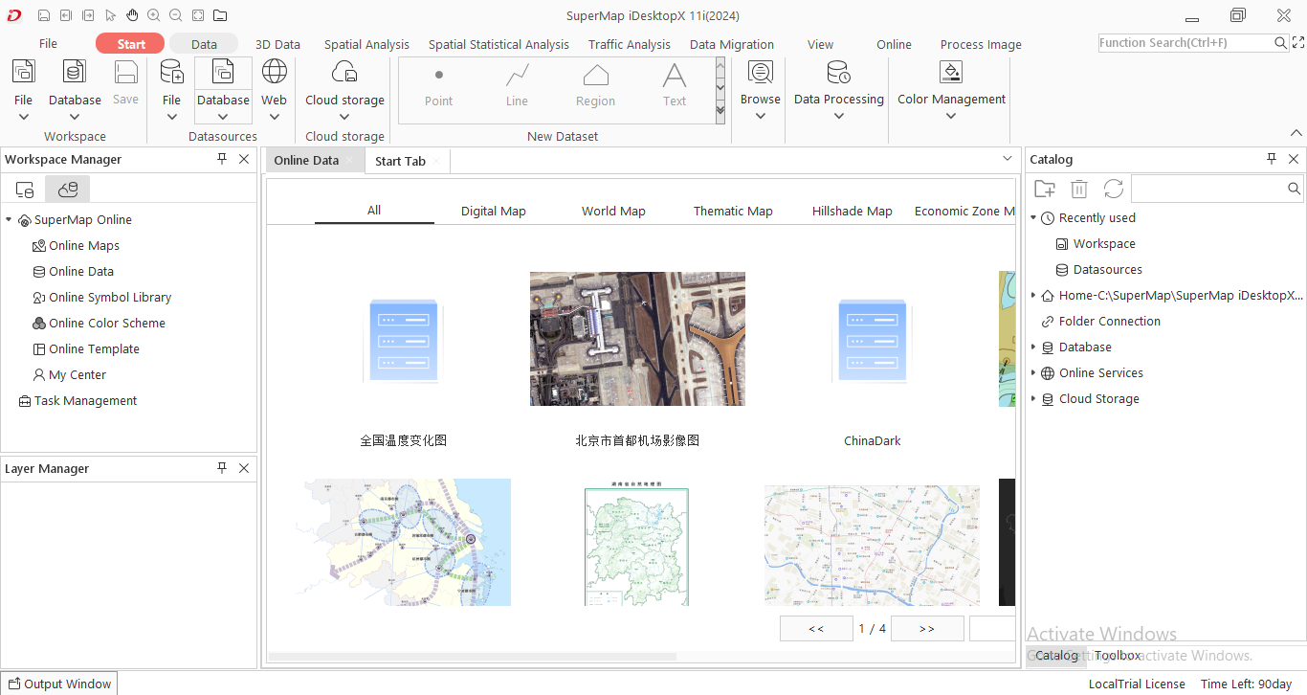
Also was resposinsoblie about evalutiang and using supermap gis desktop i11 tool

Slide 17
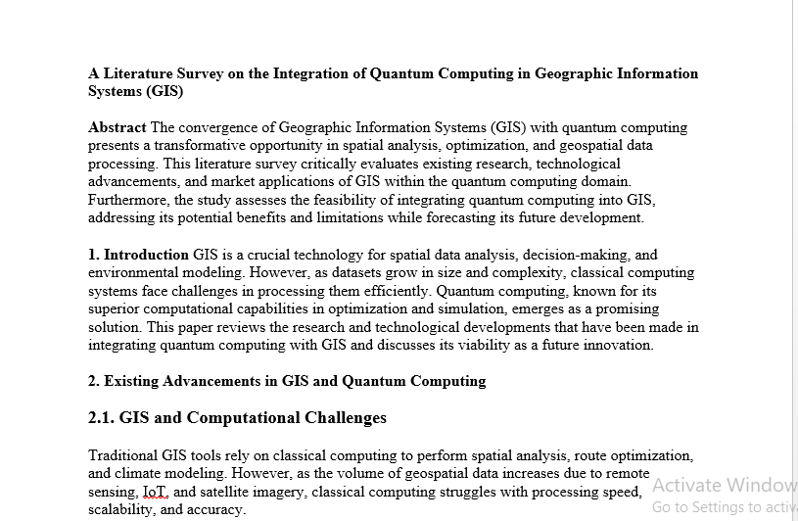
Also did a literature reviw to help in understaning the ability to work with quantum cpmputing with gis

